Slide 1

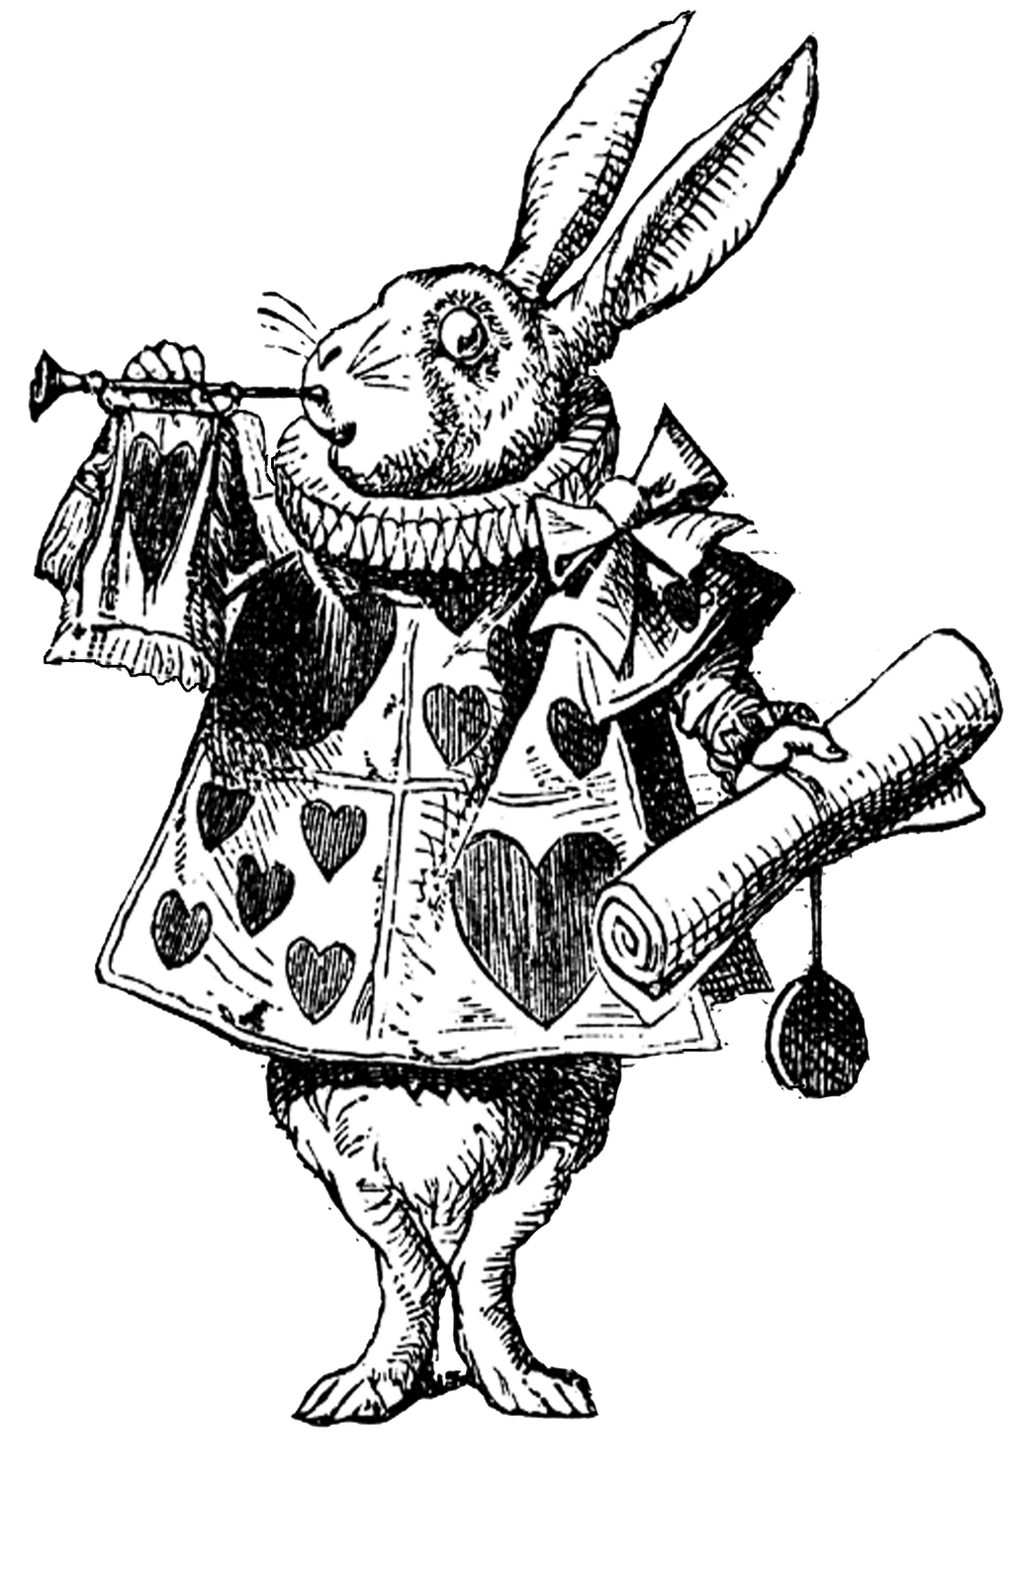
Code Quantum Presentation
By:
Fra3zz
yourlocaltrashcan
PHcodework
jagueva7

Slide 2

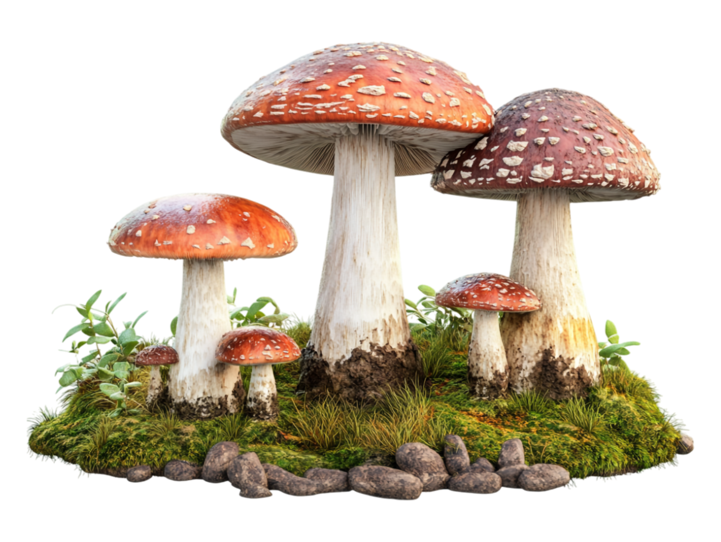
Introduction/Inspiration
Our project is a retelling of the story of Alice in Wonderland with a twist inspired by text based adventure games.
Throughout the game, the player has to choose the correct options to overcome the shenanigans of the Wonderland denizens and escape Wonderland.

Slide 3
Project Description
The player, in the role of Alice, will go through different scenarios from the original movie, such as the tea party with Hatter or falling through the rabbit hole, through console commands.
In each scenario, the user is presented with a series of choices to choose from, each resulting in a different outcome.

Slide 4
Program Sample
"Where did you say you were from?" The Hatter turns to look at you so quickly that his neck cracks slightly.
What do you say? (enter either 1 or 2):
1.) "Not here."
2.) "Oh, I'm from England."
(The player enters 1)
"You're from Not Here? Well, what a coincidence. So is my cousin!" The Hatter shakes his head as he laughs jauntily. "If I had a cousin, I mean." The Hatter then proceeds to sneeze without covering his mouth.

Slide 5
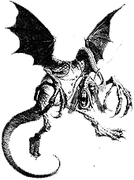
Challenges we faced
Whilst completing the project, the challenges we faced included:
Confusion with GitHub
Conflicting software requirements
Time management
Difference in coding experience

Slide 6

Conclusion
In conclusion, this project allowed us to gain more insight into both a team-based software development process and the Git operations involved with that process.

